Slide 1
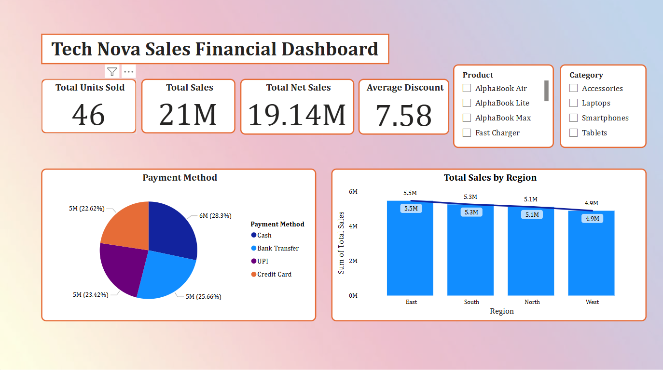

Slide 2
Product Strategy: Focus on improving low-selling products by using strategies like product bundles, cross-selling, or discounts.
Regional Focus: The West region is underperforming, so consider launching targeted marketing campaigns or promotions to boost sales there.
Payment Experience: Since most transactions are digital, continue to encourage digital payments and collaborate with apps to offer loyalty rewards or cashback.
Discount Strategy: You're offering a good average discount, but make sure these discounts are actually helping to increase overall sales, especially in different categories.

Slide 3
Final Summary
The company has strong sales potential but needs to stabilize its revenue flow. Right now, it's too risky and inconsistent. Without better sales regularity, the company could struggle to maintain steady growth and financial health in the long run.

